Slide 2
Track Maven
Submitted to:
Department of Computer Science and Engineering

Slide 3
Supervised by: Prof.Ritika Bhatt
Team Members
1.Adarsh Trivedi

Slide 4
Project Presentation Outline
Introduction
Problem Statement
Survey of Existing Systems
Project Objectives
Requirement Analysis
Solution Proposed
Features
System architecture
User Interface
Testing Plan
The Outcome Discussion
Conclusions

Slide 5
Introduction
Track Maven:A task tracker project is a software application designed to efficiently manage and monitor tasks and projects. It includes features such as task creation, assignment, prioritization, status tracking, deadline management, and reporting capabilities. Task trackers streamline workflow processes, enhance team communication, improve productivity, and ensure effective deadline management.

Slide 6
The Problem Statement
Design a task tracking tool that helps teams manage and track their projects. Implement features like creating projects, assigning tasks to team members, setting deadlines, and tracking progress.

Slide 7
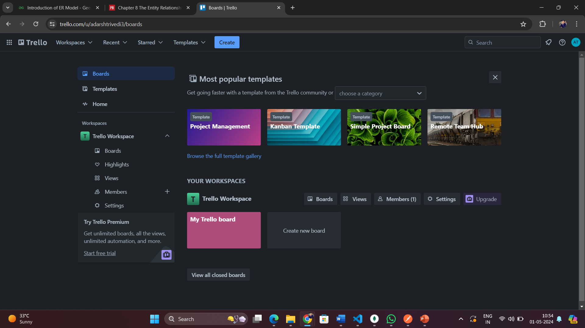
Survey of Existing Systems
Trello

Slide 8
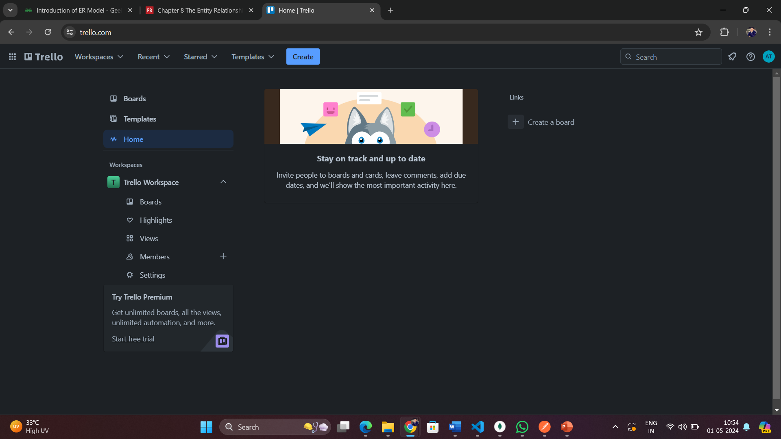
Survey of Existing Systems(Contd..)

Slide 9
Survey of Existing Systems(Contd..)
Advantages
Visual Workflow: Trello provides a highly visual and intuitive interface, allowing users to organize tasks and projects using customizable boards, lists, and cards.
Easy Collaboration: Users can easily collaborate with team members by assigning tasks, adding comments, and attaching files directly to Trello cards.
Flexible and Scalable: Trello's flexible structure adapts to various workflows and project sizes, making it suitable for personal task management as well as enterprise-level project tracking.
Integration and Automation: Trello integrates with various third-party tools and allows for automation through Power-Ups, enabling users to streamline their workflow and enhance productivity.
Disadvantages
Limited Functionality: Trello's simplicity may be a drawback for complex project management needs, lacking advanced features such as Gantt charts and time tracking.
Dependency on Third-Party Integrations: While Trello offers integration with various third-party tools, some essential features may require additional integrations, leading to a fragmented workflow.

Slide 10
Survey of Existing Systems(Contd..)
Gaps Identified
Lack of Advanced Features:Trello lacks advanced project management features such as Gantt charts and resource management, limiting its suitability for complex project requirements..
Integration Challenges: While Trello offers integrations with various third-party tools, the need for multiple integrations can lead to a fragmented workflow and increased complexity.

Slide 11
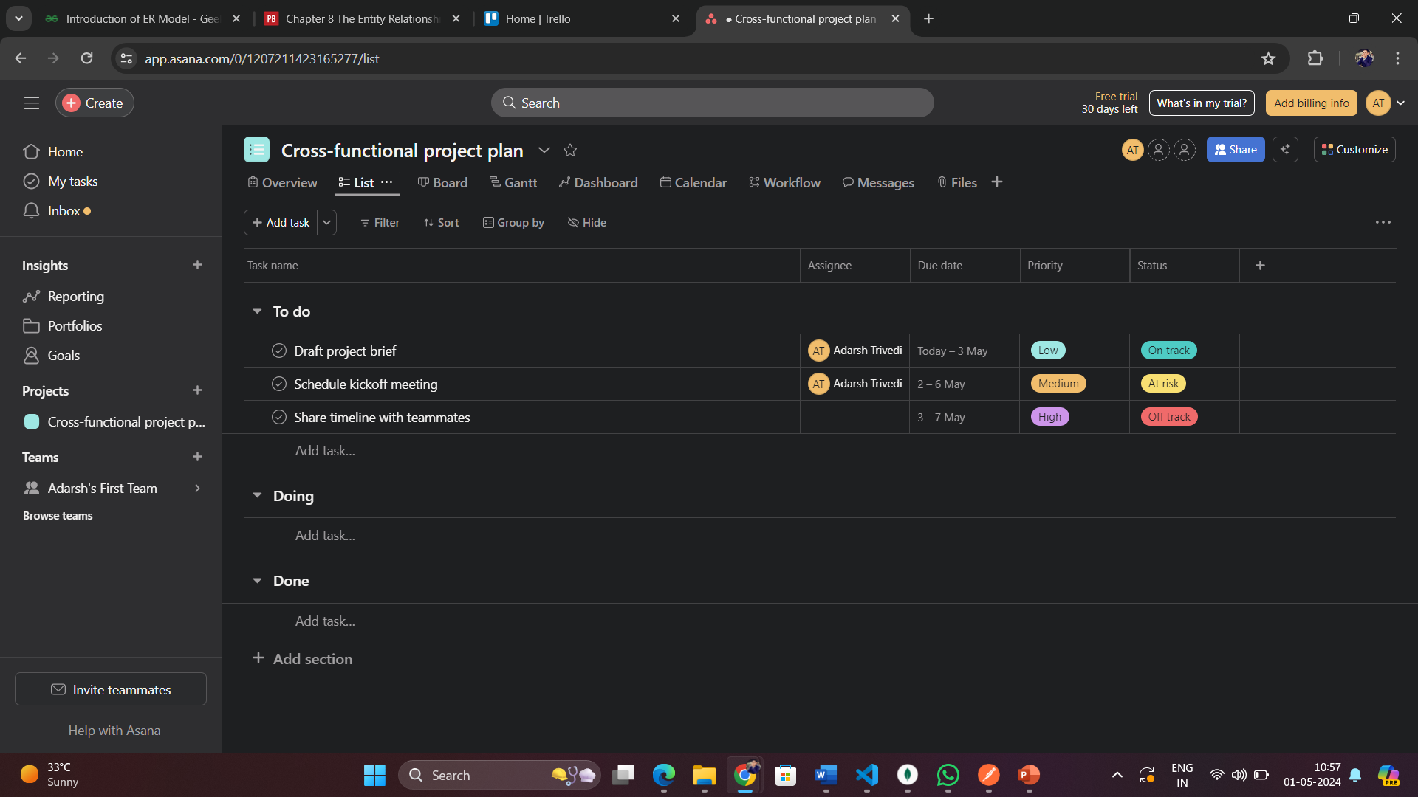
Survey of Existing Systems(Contd..)
Asana

Slide 12
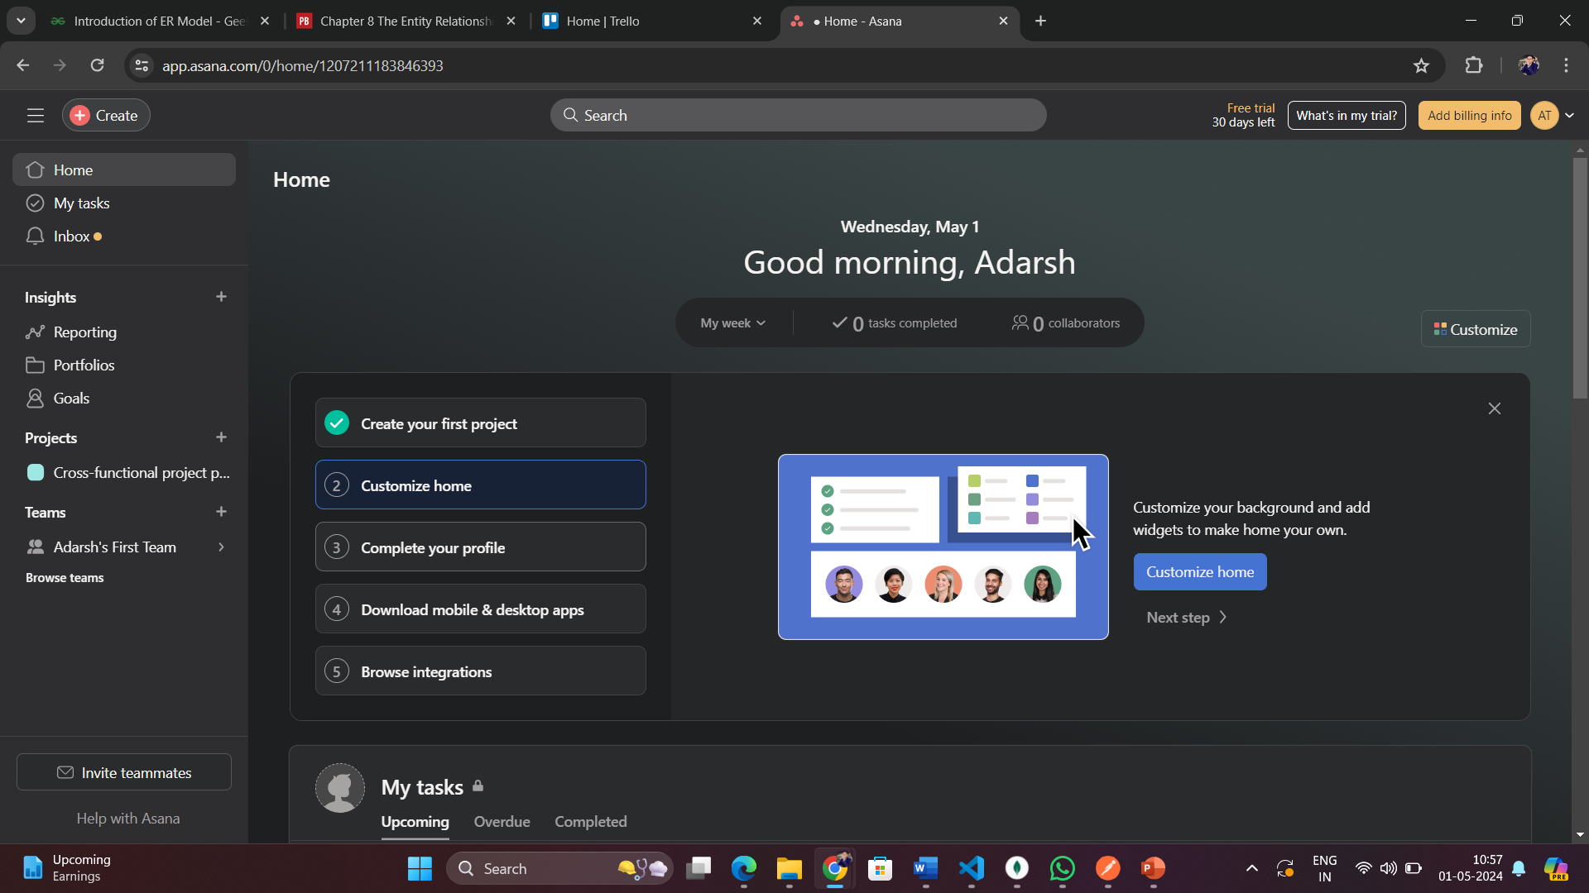
Survey of Existing Systems(Contd..)

Slide 13
Survey of Existing Systems(Contd..)
Advantages:
Comprehensive Task Management: Asana offers a wide range of task management features including task assignment, prioritization, deadlines, and progress tracking, ensuring efficient project organization.
Collaborative Workspace:Asana provides a centralized platform for team collaboration, facilitating communication, file sharing, and real-time updates, improving team productivity and project transparency.
Disadvantages
Steep Learning Curve: Asana's extensive feature set and complex interface can result in a steep learning curve for new users, requiring time and effort for onboarding.

Slide 14
Survey of Existing Systems(Contd..)
Gaps Identified
Limited Timeline View: Asana lacks a comprehensive timeline view, making it challenging to visualize project timelines and dependencies effectively.
Complexity for Small Teams:Asana's extensive feature set can be overwhelming for small teams, leading to underutilization and inefficiency.
Dependency on Integrations: While Asana offers integrations with various tools, the need for multiple integrations can create a fragmented workflow and increase complexity.

Slide 15
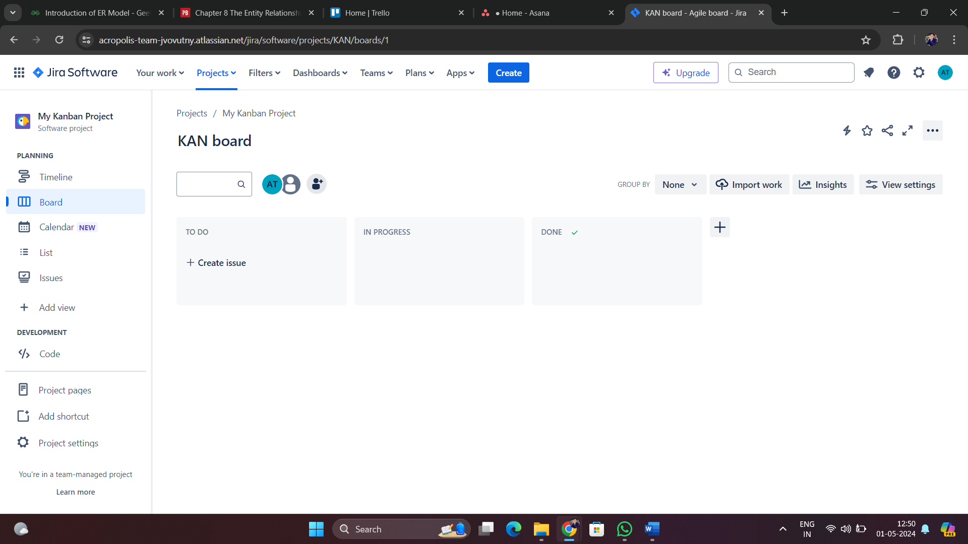
Survey of Existing Systems(Contd..)
Jira

Slide 16
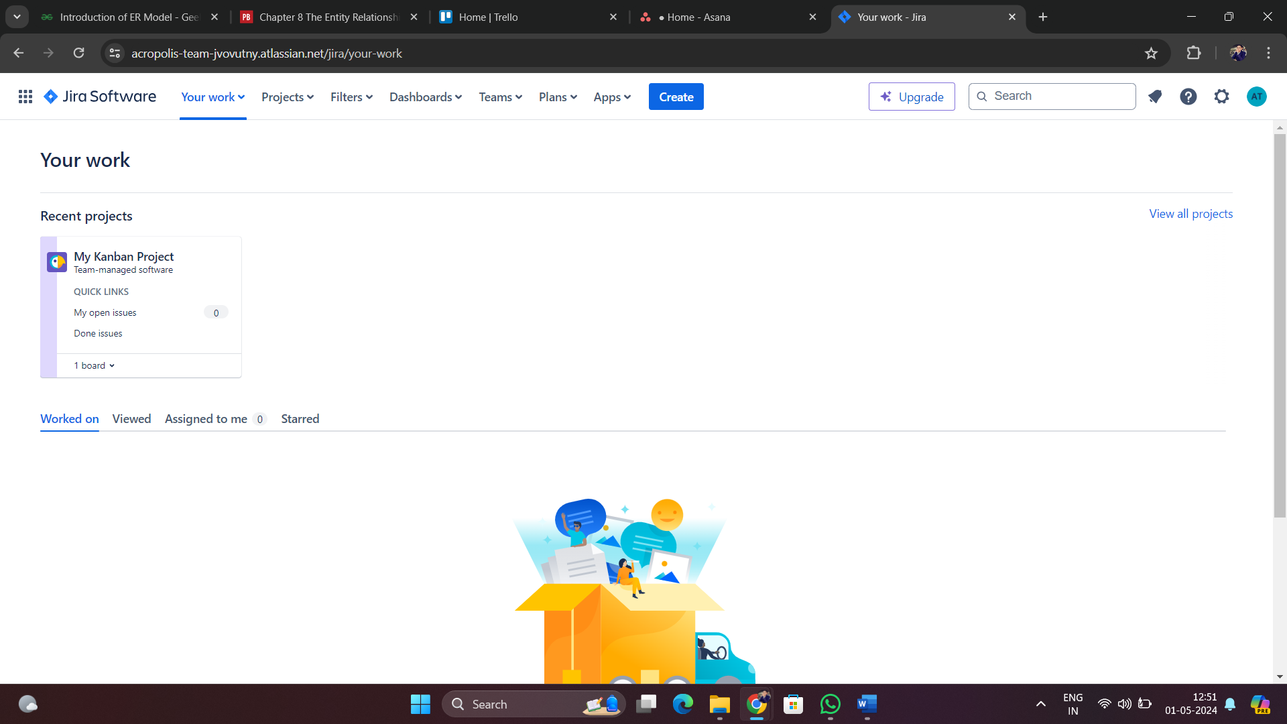
Survey of Existing Systems(Contd..)

Slide 17
Survey of Existing Systems(Contd..)
Gaps identified:
Limited User-Friendliness:
Jira's complex interface and extensive feature set may overwhelm users, especially those unfamiliar with project management software, leading to underutilization.
Inflexibility for Small Teams:
Jira's robustness may be excessive for small teams, causing unnecessary complexity and hindering efficient task management.

Slide 18
Survey of Existing Systems(Contd..)
Advantages
Comprehensive Project Management: Jira offers a wide range of project management features including issue tracking, agile boards, customizable workflows, and extensive reporting capabilities.
Scalability and Flexibility: Jira is highly scalable and customizable, making it suitable for teams of all sizes and adaptable to various project management methodologies.

Slide 19
Survey of Existing Systems(Contd..)
Disadvantages
Steep Learning Curve: Jira's extensive feature set can result in a steep learning curve for new users, requiring significant time and effort for onboarding.
Complexity and Overhead: The complexity of Jira can lead to over-customization and administrative overhead, potentially slowing down project execution and team productivity.

Slide 20
Objectives
Track Maven: The task tracker project aims to develop a comprehensive software solution for efficient task and project management. Utilizing the MERN stack, the project addresses challenges such as disorganization and poor communication. Key objectives include providing a user-friendly interface, real-time collaboration, customizable workflows, advanced automation, scalability, performance, and enhanced data visualization.

Slide 21
Requirement Analysis
Functional Requirements
User Authentication
Task Creation
Task Assignment
Todo Management
Task Tracking
Team Management
Role-Based Access
Reporting

Slide 22
Solution Proposed
Applied method and technology to develop this Project is:
React.js
Express.js
Node.js
MongoDB
Iterative Development

Slide 23
Features
User-Friendly Interface
Get Tasks:
Task Model Schema
Todo Subdocument Schema
Create Task
Assign Task
Delete Task
Update Task
Task Completion Tracking:

Slide 24
The Outcome
The Task Management Dashboard provides a visual representation of task completion status across teams. Using a bar chart, it displays the number of tasks completed on time by each team. The system categorizes tasks based on their title, description, todos, completion status, end date, and assigned date.
Additionally, the API offers endpoints to manage tasks effectively, including functionalities to fetch, create, assign, retrieve, delete, and update tasks. Authorization checks ensure that only authorized personnel, such as managers, can perform critical operations like creating tasks and assigning them to teams.

Slide 25
Conclusion
The Task Management Dashboard offers a concise overview of task completion status across different teams. Through a bar chart, it visualizes the number of tasks completed on time by each team, enabling managers to track progress effectively. The system's API provides various functionalities for efficient task management, including fetching, creating, assigning, retrieving, deleting, and updating tasks. Additionally, authorization checks ensure that only authorized personnel, such as managers, can perform critical operations like task creation and assignment, maintaining data security.

Slide 26
Acknowledgment

Slide 27
THANKS

